Slide 1
Battle of Neighborhood Week 2 Capstone
Planning OF A SCIENTIFIC CONFERENCE
March, 2020

Slide 2
Objective
To provide location of places of interest within the city of Toronto
Alleviate problems that may face Visiting Research Scientists from USA.

Slide 3
Problem Statement
Visiting Research Scientist from USA faces a difficult task in navigating and locating places of interest and finding hotels proximal to the Toronto Convention Center, Venue for the 2020 Data Mining and Data Analysis Conference. Toronto, being a huge city poses problems for first timer especially in finding ways around the city, locating places of interest such as hotels, subways, cafes, restaurants, and so forth. However, with the help of Get Me There, Inc, there is a possibility of making the adventure pleasant for the visiting scientists

Slide 4
Data Source
The data to be used for this project shall be provided using Foursquare Location Data
Data shall be grouped further to include information on restaurants, gas stations schools, cafes, hotels, and stores in this neighborhood

Slide 5
Stakeholders
Visiting Scientists to the 2020 Data Mining and Data Analysis Conference
Staffers of Get Me There Inc,
Conference Organizers
Taxi Cab Drivers

Slide 6
Resolution
Making API calls to Google maps to locate key areas of interest like cafes, restaurants, hotels, Bus Stops, Subways and street names.
Visiting scientists shall be equipped with tools needed to be well informed on what places are proximal to the Convention center.
The provision of the map would be of a priceless value to the Scientists, especially first timers in such a huge city.

Slide 7
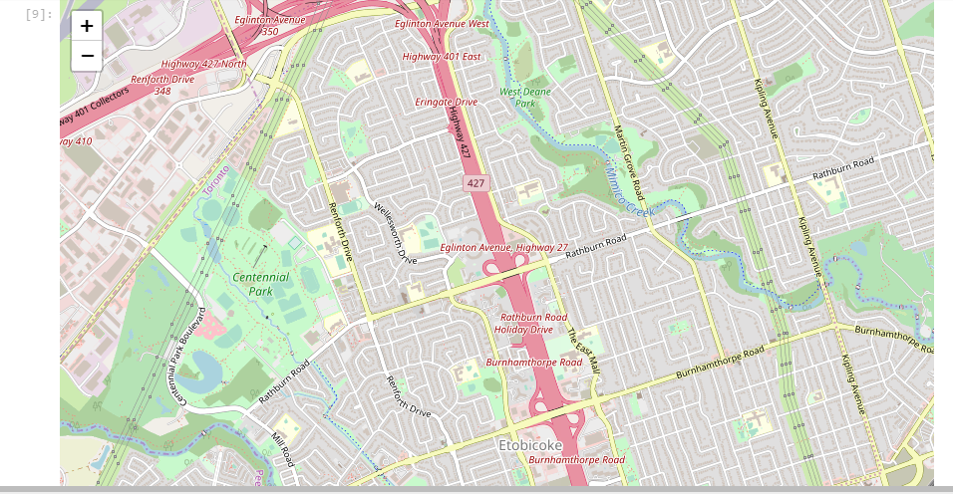
Report

Slide 8
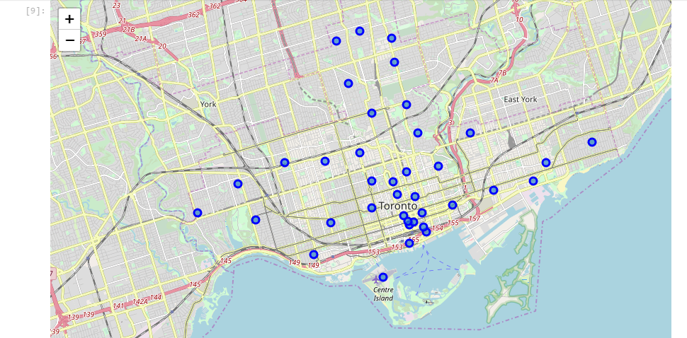
Report- Contd

Slide 9
Thank you!
Questions?

